Slide 1

PREDICTING NEXT DAY'S
STOCK MOVEMENT
2024WI_MS_DSP_422-DL_SEC61: Practical Machine Learning
Donald Wedding and Narayana Darapaneni
MSDS Northwestern University
Shreenivas V, Ezhilarasu R., Shalesh Nath Sharma, Pooja Bendre, Ritesh Kumar

Slide 2
Problem Statement
Data Overview
Data Exploration
Modelling
Results
AGENDA

Slide 3

PROBLEM STATEMENT
The project aimed to develop a sophisticated algorithmic trading system for BankNifty, leveraging a machine learning model to predict market trends and guide trading decisions using historical data.
Originally planned to include Cumulative Open Interest (COI) as a key indicator of market sentiment, the team was limited to using OHLC (open, high, low, close) and Volume data due to data availability issues.
Additionally, the data's frequency had to be reduced from 5-minute intervals to daily because of the lack of available volume data. Despite these challenges, the project pursued various machine learning models, such as Random Forest, Gradient Boosting, and LSTM networks, focusing on daily OHLC and Volume data to identify patterns signaling significant market movements.

Slide 4
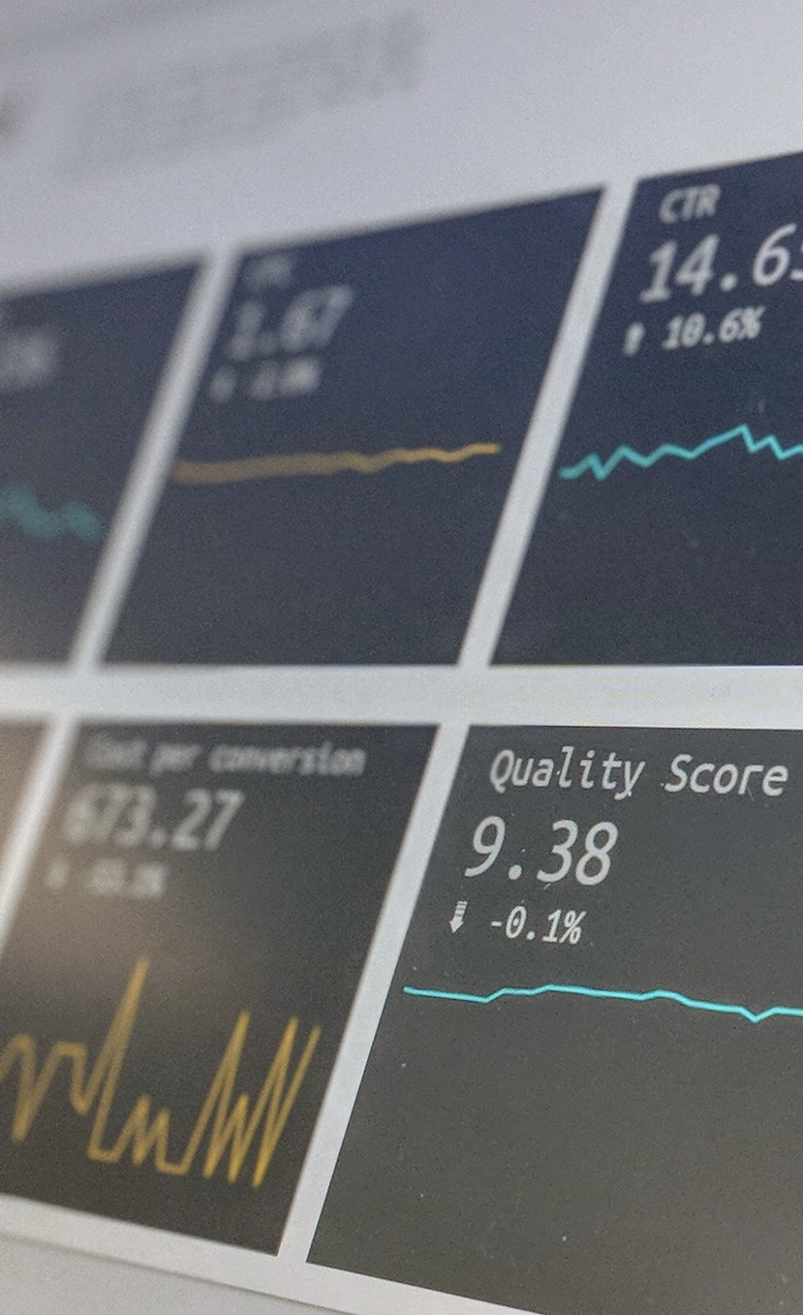
DATA OVERVIEW
From: 02-April-2007
To: 06-March-2024
Number of Datapoints: 4188
Features: Open, High, Low, close, Volume
Technical Indicators: Simple and Exponential Moving Averages, VWAP, Macd, ADX, RSI, Highs, Lows, Average Volume, etc.
Final Dataframe Shape: (3938, 32)

Slide 5
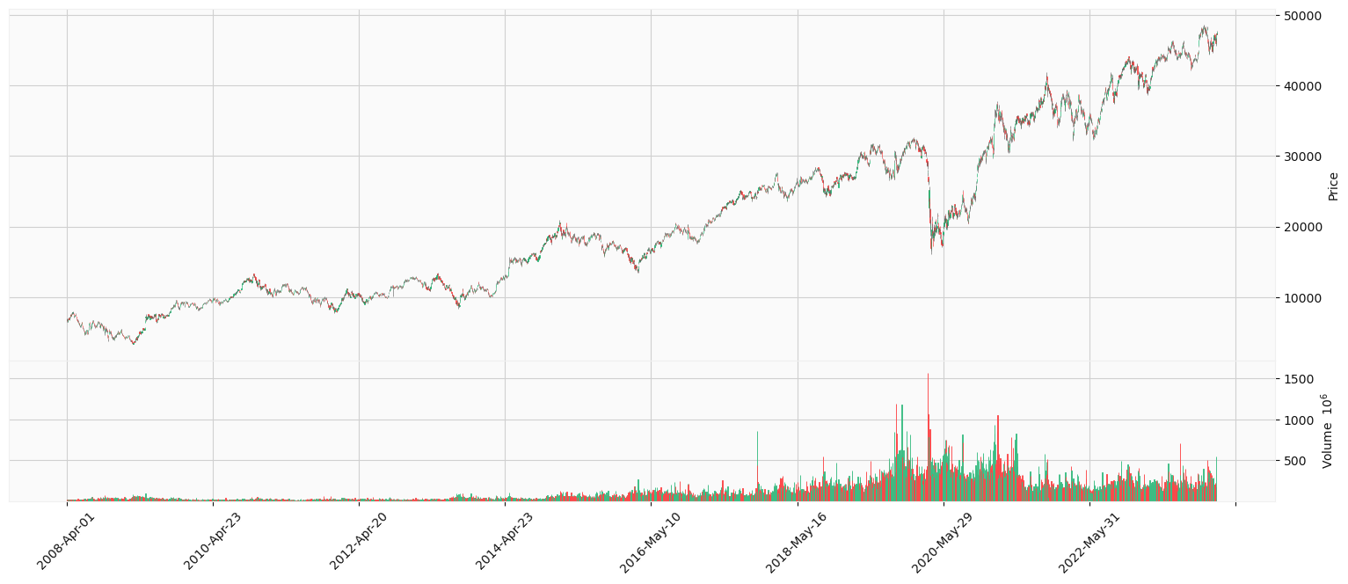
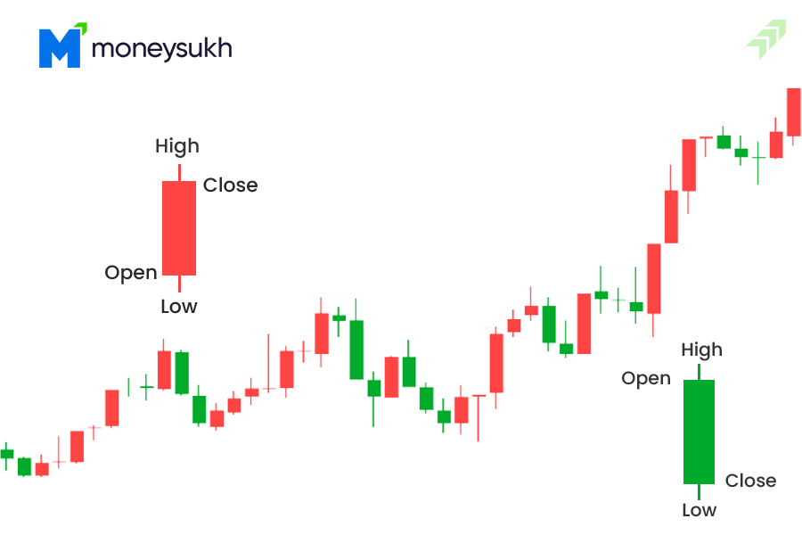
TRENDS

Slide 6
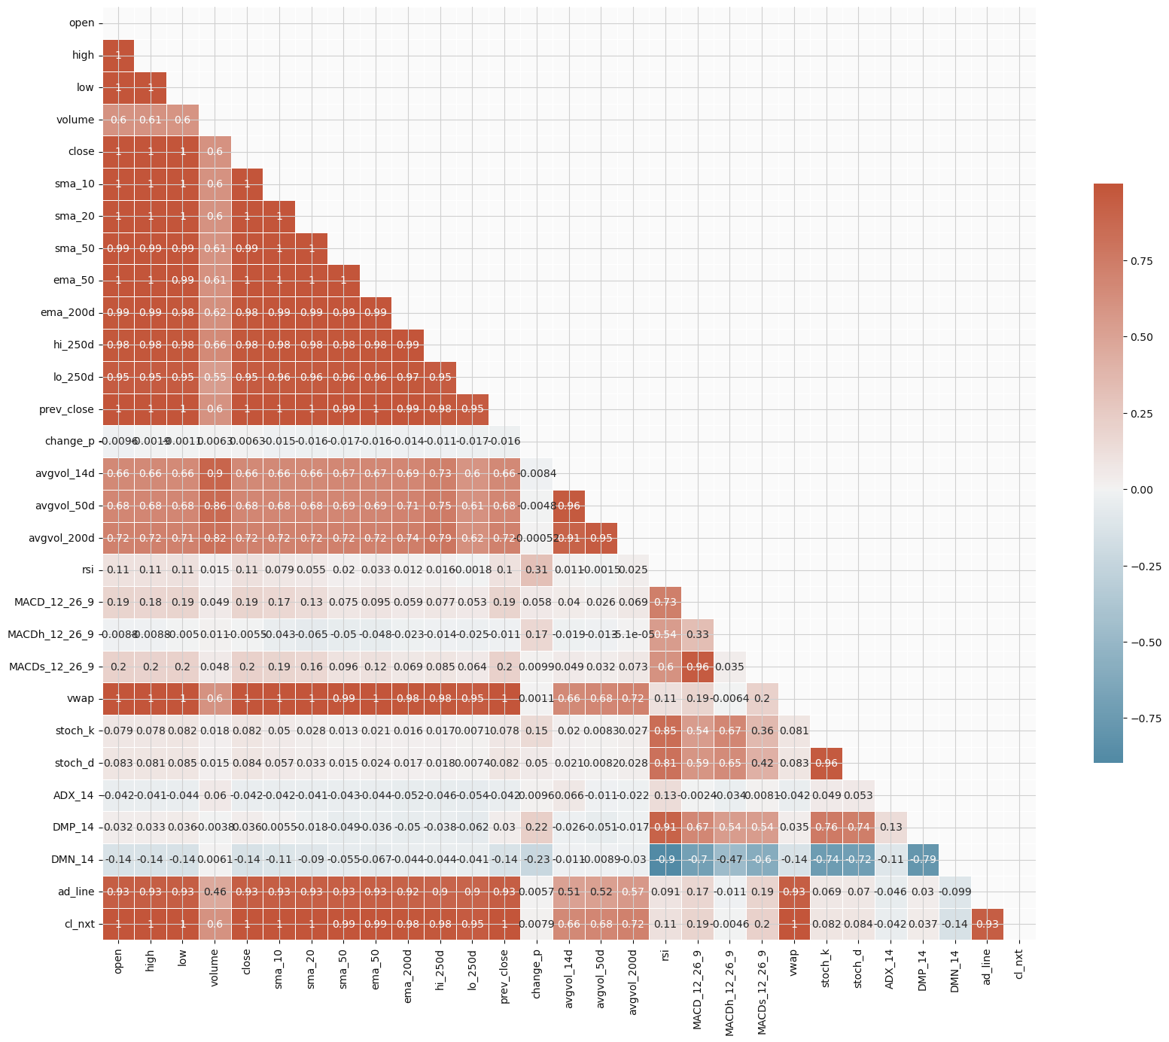
CORRELATIONS
SIGNIFICANT
prev_close 0.999236 sma_10 0.998453 sma_20 0.997003 ema_50 0.994717 sma_50 0.992751 ema_200d 0.984573 hi_250d 0.976616 lo_250d 0.953964 ad_line 0.934636 avgvol_200d 0.715903 avgvol_50d 0.680600 avgvol_14d 0.660639 volume 0.602028

Slide 7
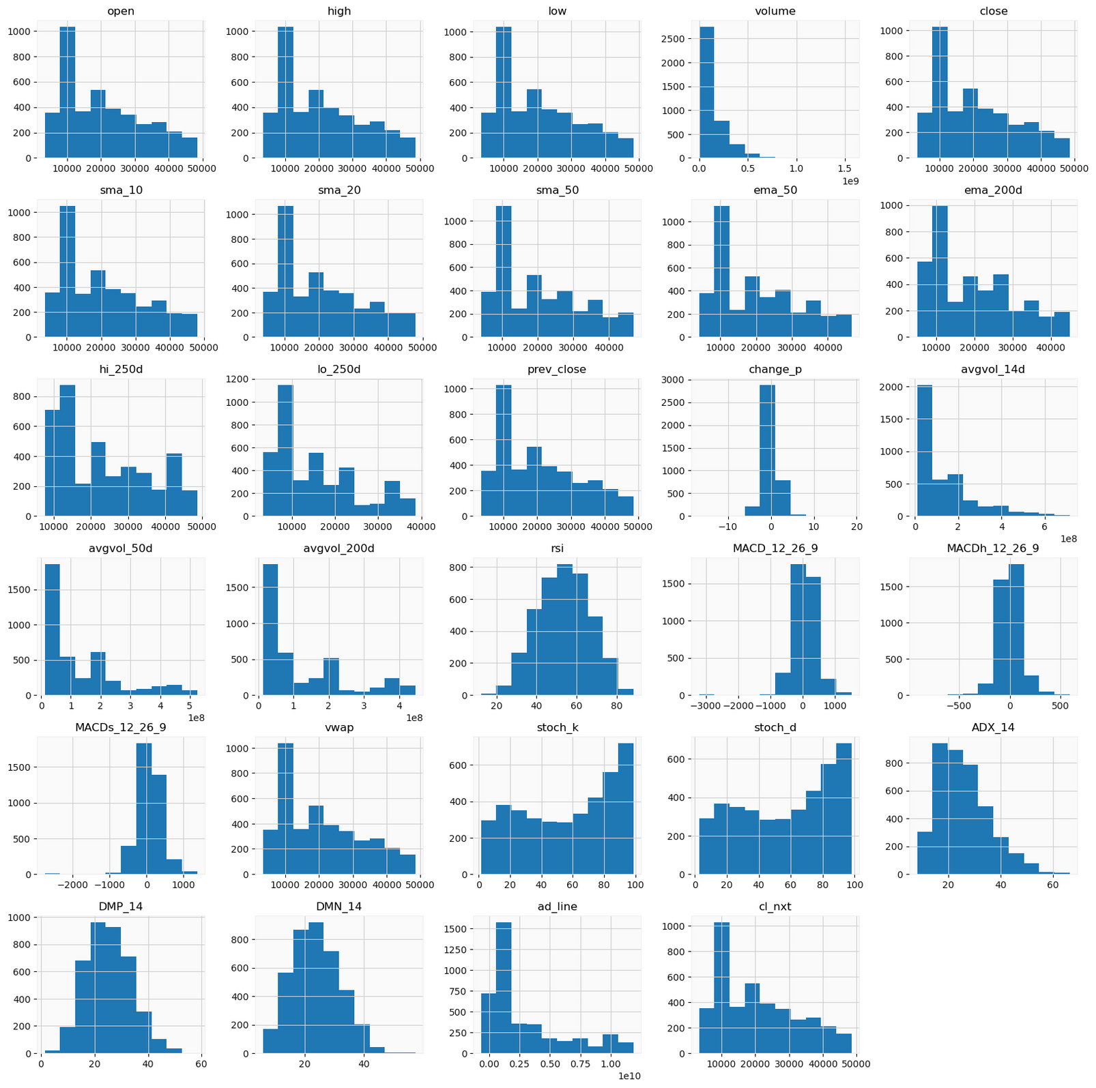
HISTOGRAMS
Open, high, low, close, SMA_10, SMA_20, SMA_50, EMA_50, EMA_200d, hi_250d, lo_250d, prev_close, and cl_nxt histograms are right-skewed, showing more low values than high.
Volume, avgvol_50d, avgvol_200d, and avgvol_14d histograms are highly right-skewed, with a focus on lower volume values and rare high volume occurrences.
The change_p histogram is normally distributed around 0, indicating symmetric fluctuations in price changes.
RSI, stock_k, stock_d, DMP_14, and DMN_14 histograms display a uniform or slightly bimodal distribution, with data spread out but some clustering.
MACD_12_26_9 and MACDh_12_26_9 histograms center around zero, with the MACD histogram slightly left-skewed, indicating a lean towards negative values.

Slide 8
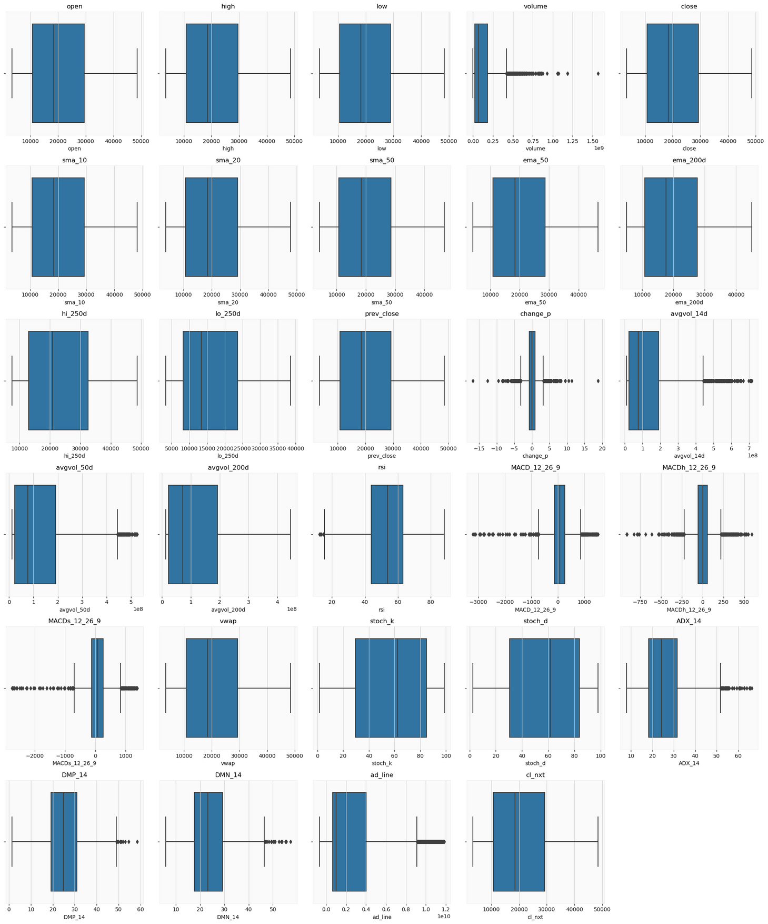
BOXPLOTS
For ‘open’, ‘high’, ‘low’, ‘close’, ‘sma_10’, ‘sma_20’, ‘sma_50’, ‘ema_50’, ‘ema_200d’, ‘hi_250d’, ‘lo_250d’, ‘prev_close’, ‘wvap’, ‘stock_k’, and ‘stock_d’, the box plots show a relatively symmetrical distribution with the median line near the center of the box, suggesting a more or less even distribution of data around the median.
The ‘volume’, ‘avgvol_50d’, ‘avgvol_200d’, and ‘avgvol_14d’ indicators have box plots with a line (median) closer to the bottom of the box, indicating a right-skewed distribution, with a few outliers indicating instances of extremely high volume.
‘change_p’, ‘MACD_12_26_9’, ‘MACDh_12_26_9’, and ‘ADX_14’ display box plots with medians close to zero but with various spreads and outliers, indicating occasional extreme values or fluctuations from the typical range.
The ‘rsi’ indicator’s box plot shows the median closer to the upper quartile, which might indicate a distribution that is slightly skewed towards higher values.

Slide 9

IDENTIFYING MODEL
Data Split Test (last 20 days), Train 80%, Validate 20%
LSTM
Lookback 20 days, Layers 2 to 20, Units: 30 to 50, LR .01, .001, .001, Epochs: 50
Keras-Tuner (Random Search) – Loss MSE .07, Layers 4, Units, 40, LR .001
Deep Neural Network
Bayesian Optimization – Layers 2 to 10, Units 32 to 512, Activation: relu, tanh, sigmoid, Epochs: 50
Mean Squared Error: 548477
Ridge, Lasso, Elastic Net, Polynomial, Regression Tree, Random Forest
Grid Search
Mean Squared Error: In the range of 38k to 220k

Slide 10
BEST MODEL
Data Split Test (last 20 days), Train 80%, Validate 20%
Next Day Open
Model Composition: A pipeline combining polynomial feature transformation (degree 2) and Ridge regression (α=0.1), indicating an approach to capture non-linear relationships with some regularization to prevent overfitting.
Performance Score: Achieved a best score of approximately -0.0000166, likely representing a negated error metric, indicating the model's selection was based on minimizing loss.
Hyperparameters: Optimal settings include a regularization strength (alpha) of 0.1 for Ridge regression and generating polynomial features up to the second degree, showing a balance between model complexity and avoiding overfitting.
Prediction Accuracy: Reported an MSE of 38987.527 on a test set, quantifying the average squared difference between the predicted and actual values, useful for evaluating model performance in context.

Slide 11
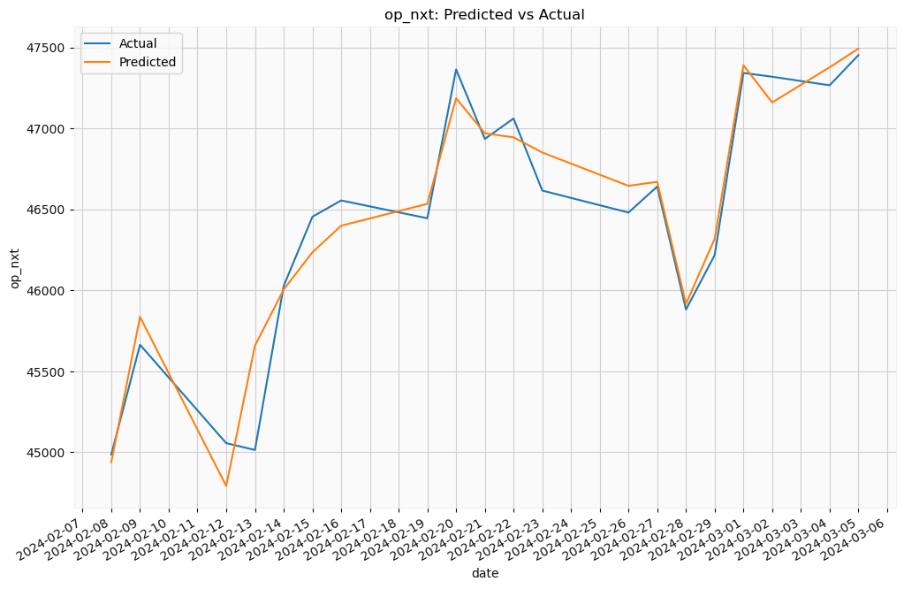
NEXT DAY OPEN
16 out of 20 times, the model was able to get the direction right
8 out of 20 times, the difference between actual and predicted values was less than 100 points.
16 out of 20 times, the difference between actual and predicted values was less than 200 points.

Slide 12
BEST MODEL
Data Split Test (last 20 days), Train 80%, Validate 20%
Next Day High
Model Composition: Utilizes a pipeline with polynomial feature generation (degree 2) and Ridge regression (alpha=0.1), designed to handle non-linear patterns and moderate regularization to combat overfitting.
Performance Score: Achieved a best score of about -0.0000285, likely a negated error metric, indicating selection based on minimizing predictive error.
Selected Hyperparameters: Determined optimal settings to be a Ridge regression regularization strength (alpha) of 0.1 and polynomial features up to the second degree, aiming for complexity control and model accuracy.
Test Set Performance: Registered an MSE of 127243.056, measuring the model’s predictive error, essential for assessing its effectiveness in real-world applications.

Slide 13
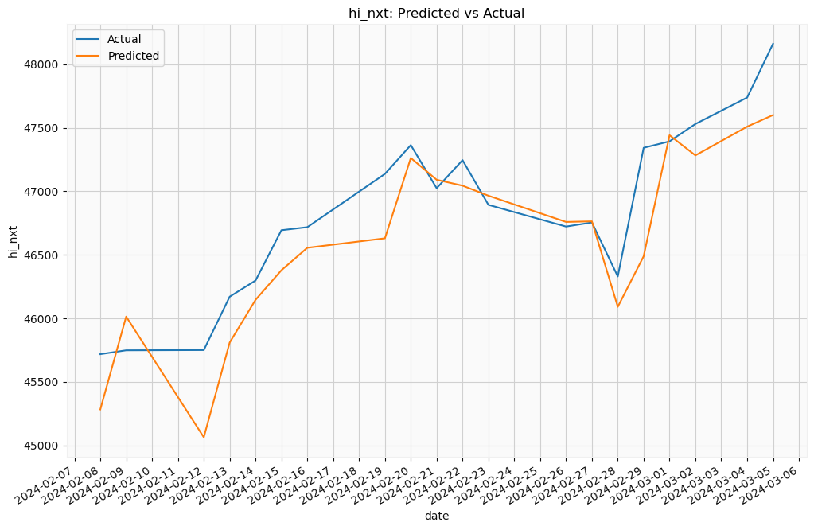
NEXT DAY HIGH
15 out of 20 times, the model was able to get the direction right.
5 out of 20 times, the difference between actual and predicted values was les than 100 points.
8 out of 20 times, the difference between actual and predicted values was les than 200 points.

Slide 14
BEST MODEL
Data Split Test (last 20 days), Train 80%, Validate 20%
Next Day Low
Model Composition: The pipeline for "lo_nxt" comprises polynomial feature transformation (up to degree 2) and Ridge regression with an alpha of 0.1, aimed at capturing non-linearities and ensuring regularization.
Performance Score: Achieved a best score of approximately -0.0000329, likely indicating a minimized error metric in model selection.
Optimal Parameters: The model's effectiveness is attributed to a regularization strength (alpha) of 0.1 and polynomial features of second degree, balancing complexity and overfitting control.
Prediction Accuracy: The Mean Squared Error (MSE) on a test dataset is 94898.916, providing a measure of the model's predictive error and effectiveness in this specific application.

Slide 15
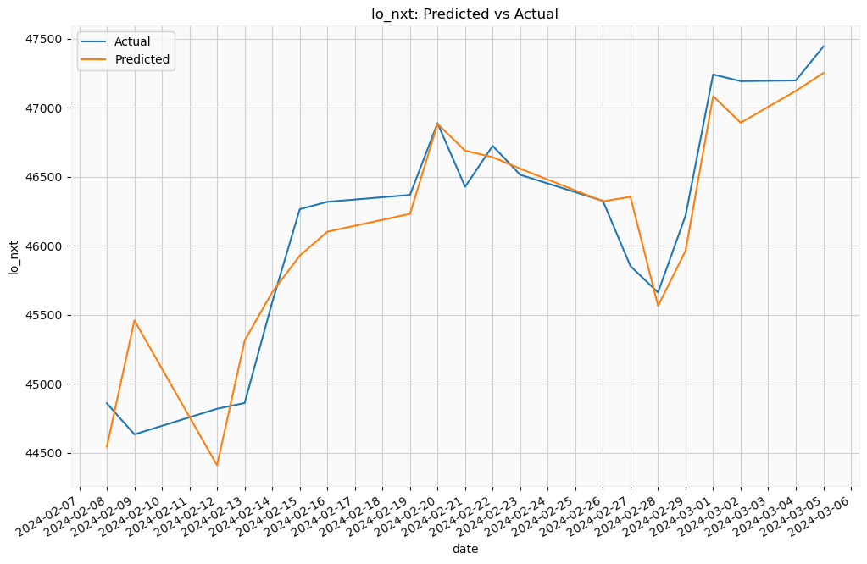
NEXT DAY LOW
15 out of 20 times, the model was able to get the direction right.
7 out of 20 times, the difference between actual and predicted values was les than 100 points.
10 out of 20 times, the difference between actual and predicted values was les than 200 points.
c
c

Slide 16
BEST MODEL
Data Split Test (last 20 days), Train 80%, Validate 20%
Next Day Close
Model Composition: For "cl_nxt", a pipeline with polynomial feature engineering (degree 2) and Ridge regression (α=0.1) is used to handle non-linear patterns and apply slight regularization.
Performance Score: The model achieved a best score of approximately -0.0000529, suggesting the score is a negated error metric used for model optimization.
Optimal Parameters: The configuration achieving this performance uses a Ridge regularization strength of 0.1 and generates polynomial features to the second degree, aimed at preventing overfitting while capturing complexity.
Prediction Accuracy: It reports a Mean Squared Error (MSE) of 222425.597 on test data, indicating the average squared prediction error and providing insight into the model's prediction quality.

Slide 17
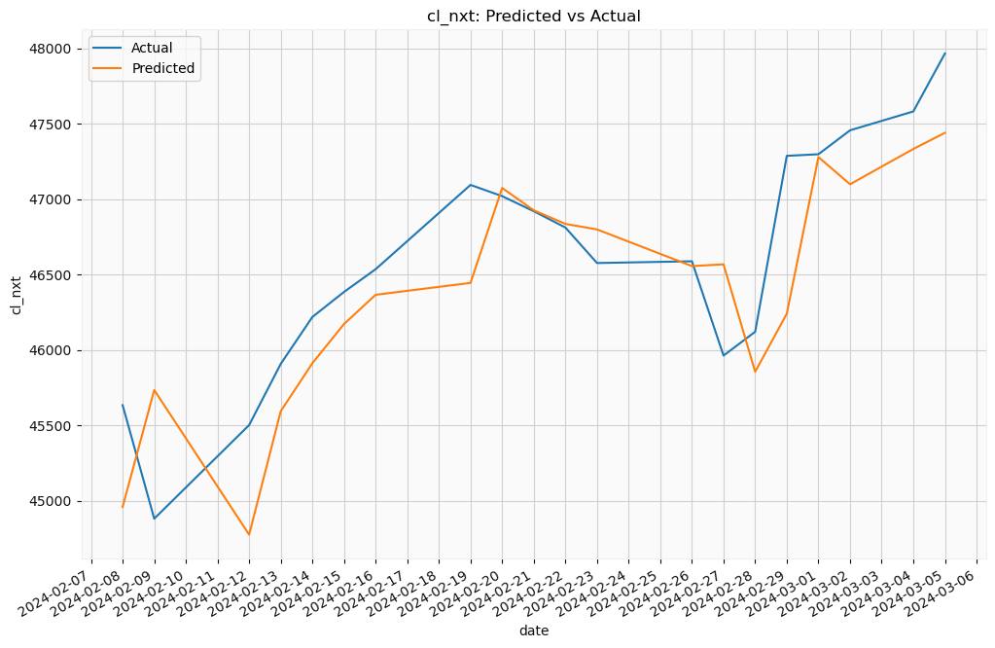
NEXT DAY CLOSE
11 out of 20 times, the model was able to get the direction right.
5 out of 20 times, the difference between actual and predicted values was les than 100 points.
6 out of 20 times, the difference between actual and predicted values was les than 200 points.

Slide 18



CONCLUSION
For next day open predictions, the model had an 80% success rate in direction and was within 200 points 80% of the time.
For next day high predictions, the model had a 75% success rate in direction and was within 200 points 40% of the time.
For next day low predictions, the model had a 75% success rate in direction and was within 200 points 50% of the time.
For next day close predictions, the model had a 55% success rate in direction and was within 200 points 30% of the time.

Slide 19

THANK YOU

